Slide 1
FEDERAL TAX UPDATE
Samuel A. Donaldson
Georgia State University College of Law
Atlanta, Georgia

Slide 2
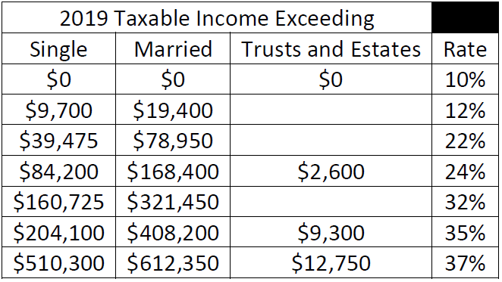
2019 Federal Income Tax Brackets
Individuals, Estates, Trusts
ORDINARY INCOME

Slide 3
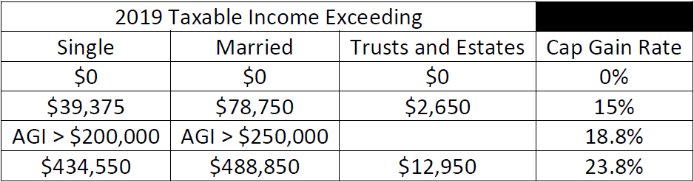
2019 Federal Income Tax Brackets
Individuals, Estates, Trusts
CAP GAIN DIVIDEND INCOME

Slide 4
Increased basic exclusion amount to $10 million, adjusted for post- 2011 inflation
Retained complete step-up in basis for property acquired from a decedent
The 2017 Act and the Federal Wealth Transfer Taxes
Scheduled to revert to $5 million exclusion, adjusted for post-2011 inflation, in 2026
Estimated 10-year revenue cost from doubling exclusion = $83 billion

Slide 5
Federal Wealth Transfer Tax Basic Exclusion Amount
Date of death | Basic exclusion amount
2011 | $5,000,000
2012 | $5,120,000
2013 | $5,250,000
2014 | $5,340,000
2015 | $5,430,000
2016 | $5,450,000
2017 | $5,490,000
2018 | $11,180,000
2019 | $11,400,000

Slide 6


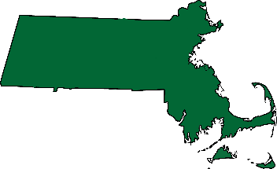

North Carolina Dept. of Revenue v. The Kimberley Rice Kaestner 1992 Family Trust
Grantor
Trustee
Assets
NONGRANTOR TRUST
with undistributed income
Beneficiary

Slide 7
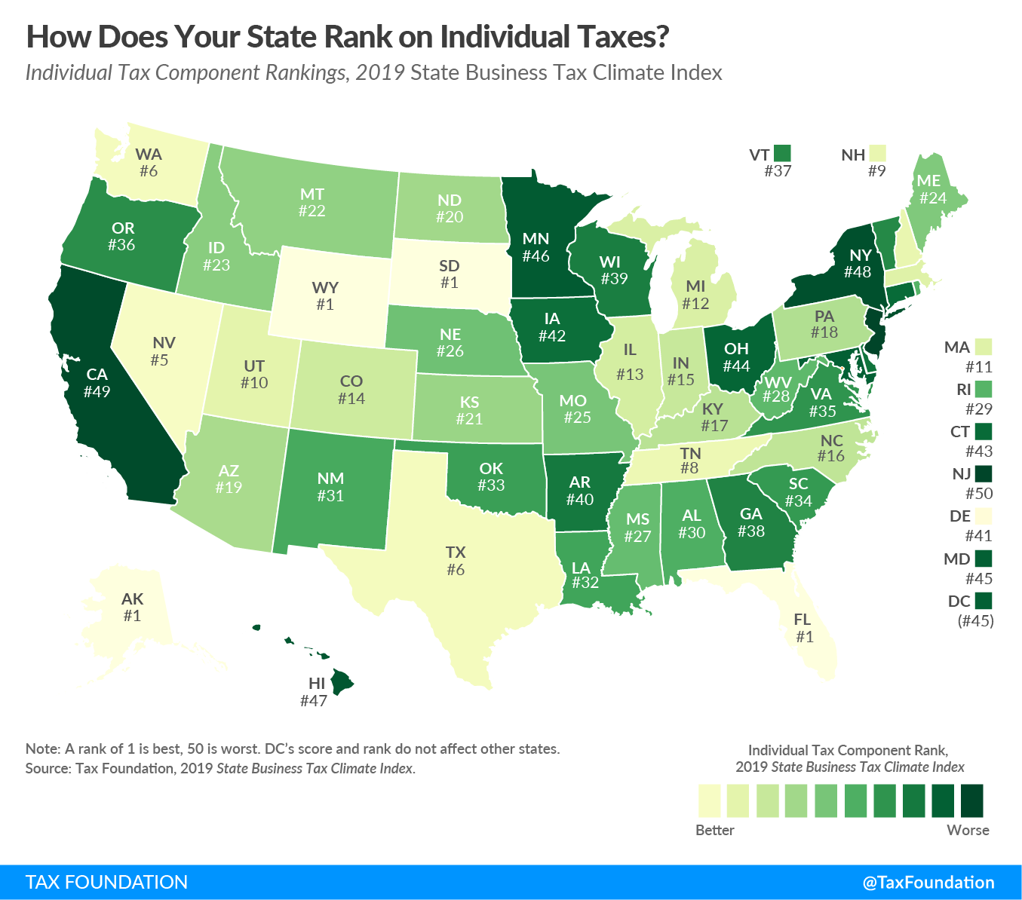
Understanding the $10,000 cap on state and local taxes
Same cap for singles and MFJ
Applies to personal taxes
Donations in lieu of taxes (TD 9864)
Trusts may be helpful
Tax benefit rule applies

Slide 8
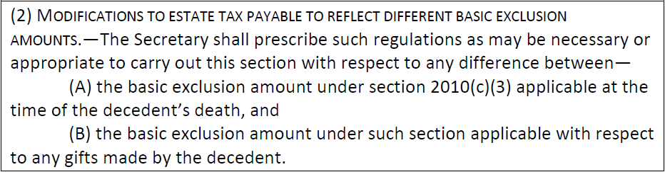
Section 2001(g)(2) (amended 2017)
Proposed Anti-Clawback Regulations
Proposed Regulation §20.2010-1(c): An estate may compute the unified credit using the basic exclusion amount applicable to gifts made during life or the basic exclusion amount applicable on the date of death

Slide 9
Portability Election
Does not apply for generation-skipping transfer tax purposes!
Surviving spouse can claim the unused exclusion of a deceased spouse for estate and gift tax purposes
Unused exclusion of the LAST DECEASED SPOUSE
Basic Exclusion Amount
+ Deceased Spousal Unused Exclusion Amount
APPLICABLE EXCLUSION AMOUNT
See Rev. Proc. 2017-34 for relief from late exclusion
Must timely file Form 706 to claim!

Slide 10
Section 199A Deduction for Qualified Business Income
Definitions
$160,700 < T.I. ≤ $210,700
ZONE 2
Deduct 20% of qualified business income
Reduced if: specified service trade or business
Reduced if: “wage-basis” amount < 20% QBI
$321,400 < T.I. ≤ $421,400 for MFJ
T.I. > $210,700
ZONE 3
Deduct 20% qualified business income (or, if less, “wage-basis” amount)
No deduction if: specified service trade or business
> $421,400 for MFJ
Qualified business income = net ordinary business income
Specified service trade or business = listed professions & those where principal asset = “reputation or skill” of 1+ employees/owners
“Wage-basis” amount = (1) 50% W-2 wages, or (2) [25% W-2 wages + 2.5% unadjusted basis after acquisition of all depreciable assets]
T.I. ≤ $160,700
ZONE 1
Deduct 20% of qualified business income
Applies to any business activity
≤ $321,400 for MFJ

Slide 11
Contemporary Tax Strategies
CHANGE RELATIONSHIP WITH LAND
CHARITABLE ROLLOVERS EVEN BETTER
01
• $10,000 cap on state and local taxes doesn’t apply if property held for business or investment
• Rental income may qualify for 199A deduction
04
• Donors age 70.5+ can direct IRA custodian to pay RMD to charity
• No deduction, but also no income
MAXIMIZE CHARITABLE GIFTS
ENABLE STRATEGIES IN CASE EXCLUSION DROPS
02
05
• Bunching
• Donor-advised funds
• Allow spouse to make small gift of QTIP corpus
• Contemplate “upstream” transfers to parents
HOARDING IS THE NEW BLACK
KEEP PLANNING FLEXIBLE
03
06
• Basis step-up may matter more
• Gifting may make sense in 2025
• Swap powers
• Trust protectors

Slide 12
Other Key Developments
ESTATE OF JONES
PARSONAGE EXCLUSION CASES
01
03
Tax Court allows for “tax-affecting” in valuing pass-through entity interest
It’s constitutional, but must follow formalities
PLR 201933005
MANCINI v. COMMISSIONER
02
04
Portion of 23andMe testing may be deductible medical expense
Gambling losses not casualties

Slide 13
Thank you

